Slide 1

Unit 14

Slide 2

Unit 14
I remember meeting all of
you in Grade 7.

Slide 3



Slide 4


1. To learn to write a person or an
event from junior high school that
your will never forget.
2. To finish Self Check.

Slide 5


Slide 6

Think of a person or an event from junior high school that you will never forget. Make some notes about how this person or event changed your life in some way.
3a

Slide 7
Who is the person?/ What is the event?
When and where did you first meet this person?/ When and where did this event happen?
How did you feel when you met this person?/ How did you feel when this event happened?

Slide 8
How did this person help you?/ What happened later?
How has this person’s advice/event changed your life?

Slide 9
Write a passage about the person or event you thought about in 3a.
3b
Describe the person/event.
Explain how you feel about this person/ event.
Describe how this person/event has changed your life.

Slide 10
写作指导
If you want to write about a person …
What you want to tell him / her
How you’ve been changed
The first time you meet
The person
How he / she helped you
Appearance & personality
Things happened to you
Notes:
10

Slide 11
一个难忘的人
方法：
1. 对人物的出场、肖像进行描写。简要介绍该人物。
2. 选择一个角度，通过对某些事情的叙述，更加生动地描写人物，描写该人物如何对你产生了影响。
3. 总结自己对人物的评价、情感等。

Slide 12
Words preparation:
Appearance：
good-looking pretty lovely slim overweight middle-aged fit wear
glasses always smile

Slide 13
Personality:
brave self-confident warm-hearted
patient easy-going outgoing energetic forgetful generous hardworking helpful humorous optimistic punctual talented good-tempered straightforward considerate honest

Slide 14
If you want to write about an event …
What you want to tell him / her
How you’ve been changed
When and where
The event
What happened later
What happened
Your feelings

Slide 15
一件难忘的事
方法：
1. 交代清楚时间、地点和人物，一般用过去式。
2. 详细描述事情发生的经过和结果。
3. 发表对此事的看法和感受。

Slide 16
You may begin like this：
1. I once had an experience…
2. It was the most unforgettable experience
that has ever happened in my life.
3. The most unforgettable experience in my
memory was that one day my classmates
and I went to the park.
4. I will never forget the military training.
5. There are a lot of memories in my heart that I
can’t forget. When I was … years old, I ...

Slide 17
6. As we all know, everyone has something
special in his life. I think I will never forget
… because on that day …
7. I think my junior high was wonderful,
because it taught me to be …
8. Whenever I open the book full of photos, I
always look back when I …
9. I still remember the most valuable time that
I have ever had.
10. Everyone has a different junior high. It
may be wonderful, exciting or hard. I have
a …junior high.

Slide 18
Your feelings
1. I think this is the most unforgettable
experience in my memory.
2. On that day, I began to feel that I have the duty for my life. And I must be stronger.
3. I felt that I was growing up, and I should
be responsible for myself.
4. How exciting and unforgettable the
experience was!

Slide 19
5. It’s really an important day to me and
I’ll learn to be … all the time.
6. Junior high is a precious memory
without pressure, competition and lots
of homework.
7. From this experience, I learnt that I
should be careful. If I am careless, I
will lose a lot of chances.

Slide 20
【写作任务】
某英文杂志社正在举办题为“The teacher I will never forget”的征文活动。请你结合自身经历，写一篇英语短文向该杂志社投稿。
【思路点拨】
1. 定基调
体裁：记叙文
时态：以一般现在时和一般过去时为主
人称：第一人称和第三人称
2. 谋布局、写句子

Slide 21
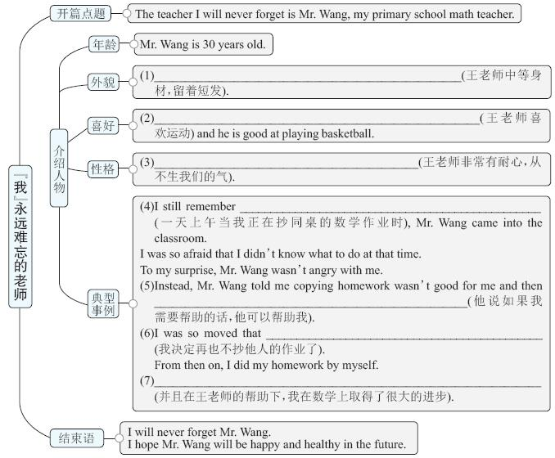

Slide 22
Mr. Wang is of medium build and has
short hair
Mr. Wang likes / loves (playing) sports
Mr. Wang is very patient and is
never angry with us

Slide 23
one morning while I was copying my deskmate's math homework
he said he could help me if I needed help
I decided not to copy anyone's
homework anymore
And with Mr. Wang's help, I made great / much
progress in math

Slide 24
3. 巧衔接
本文中体现了语义搭配这一通过词汇纽带来使上下文紧密连贯的衔接方式。如本文中的 ... years old, of medium build, has ... hair, likes, is good at, patient, is never angry with, still remember, will never forget这些表达都与描写人物相关联，从而使文章成为一个有机统一体。

Slide 25
【参考范文】
The teacher I will never forget
The teacher I will never forget is Mr. Wang, my primary school math teacher.
Mr. Wang is 30 years old. He is of medium build and has short hair. He likes sports and he is good at playing basketball. He is very patient and is never angry with us.

Slide 26
I still remember one morning while I was copying my deskmate's math homework, Mr. Wang came into the classroom. I was so afraid that I didn't know what to do at that time. To my surprise, he wasn't angry with me. Instead, he told me copying homework wasn't good for me and then he said he could help me if I needed help.

Slide 27
I was so moved that I decided not to copy anyone's homework anymore. From then on, I did my homework by myself. And with his help, I made great progress in math.
I will never forget Mr. Wang. I hope he will be happy and healthy in the future.

Slide 28


1 What happened in junior high that made you have these feelings? Complete the chart.
Feelings | Memories/ Experiences
excited
happy
worried
I felt most excited when our class won the sports meeting.
I was happy when my friends hold a birthday party for me.
I felt worried when our teacher told us that she was giving us a surprise test.

Slide 29
I was sad when I had a fight with my best friend and we didn’t talk to each other for a week.
sad
tired
proud
shy
I was tired after staying up late at night to study.
I felt proud when our class won the first prize in the school sports meet.
I felt shy on the first day of Grade 7 and did not dare to talk to anyone.

Slide 30
2 Fill in the blanks with the correct forms of the verbs in brackets.
I can’t _______ (believe) that today is the last day of junior high school. I still __________ (remember) the first day of Grade 7 like it was yesterday. I used to _____ (be) a really shy person, so on the first day of junior high, I ____ (be) so scared and nervous.
believe
remember
be
was

Slide 31
I _______ (think) that I would never make any friends. But now, I _______ (realize) that I was just being silly. Since then, I __________ (make) so many good friends and I ___________ (share) so many good memories with them. Even though I ____ (be) sad that junior high is over, I ___________ (look) forward to new experiences in senior high!
thought
realize
have made
have shared
am
am looking

Slide 32


Ⅰ. 根据语境，从方框中选择恰当的单词或短
语填空，有的需要变换形式。
in the future, because of, separate from, wing, look forward to
wings
1. Sara wishes to have _________________
and fly like a bird.
2. This house is _________________ the
next by a garden.
separated from

Slide 33
in the future, because of, separate from, wing, look forward to
3. Many beautiful fishes are fast disappearing
_________________ the water pollution.
4. —Where does your little daughter want to go
during her holidays?
—She always _________________ going to
Paris.
5. Jenny wants to be a reporter ______________
because she likes to interview people.
because of
looks forward to
in the future

Slide 34
Ⅱ. 阅读短文，从方框中选择恰当的单词并
用其适当形式填空，使短文完整、通顺。
method, double, caring, wing, graduate, overcome
Hey, I'm Luke. How fast time goes by! I have spent three years at my junior high school. I'll (1)__________ soon. And it's time to say goodbye to my teachers and classmates. I'd like to say a special “thank you” to my English teacher Mrs. Trent.
graduate

Slide 35
method, double, caring, wing, graduate, overcome
When I came here 3 years ago, my English wasn't good. But Mrs. Trent was (2)__________ and patient. She gave me a good (3)__________ to learn English. She helped me (4)__________ many difficulties. Then I put in more effort and my English exam scores (5)__________. She really helped me a lot. She taught me so much and gave me (6)__________ to fly. I'm thankful to Mrs. Trent.
caring
method
(to) overcome
doubled
wings

Slide 36


Finish your passage about the person or event you thought about in 3a.

Slide 37


